Slide 1
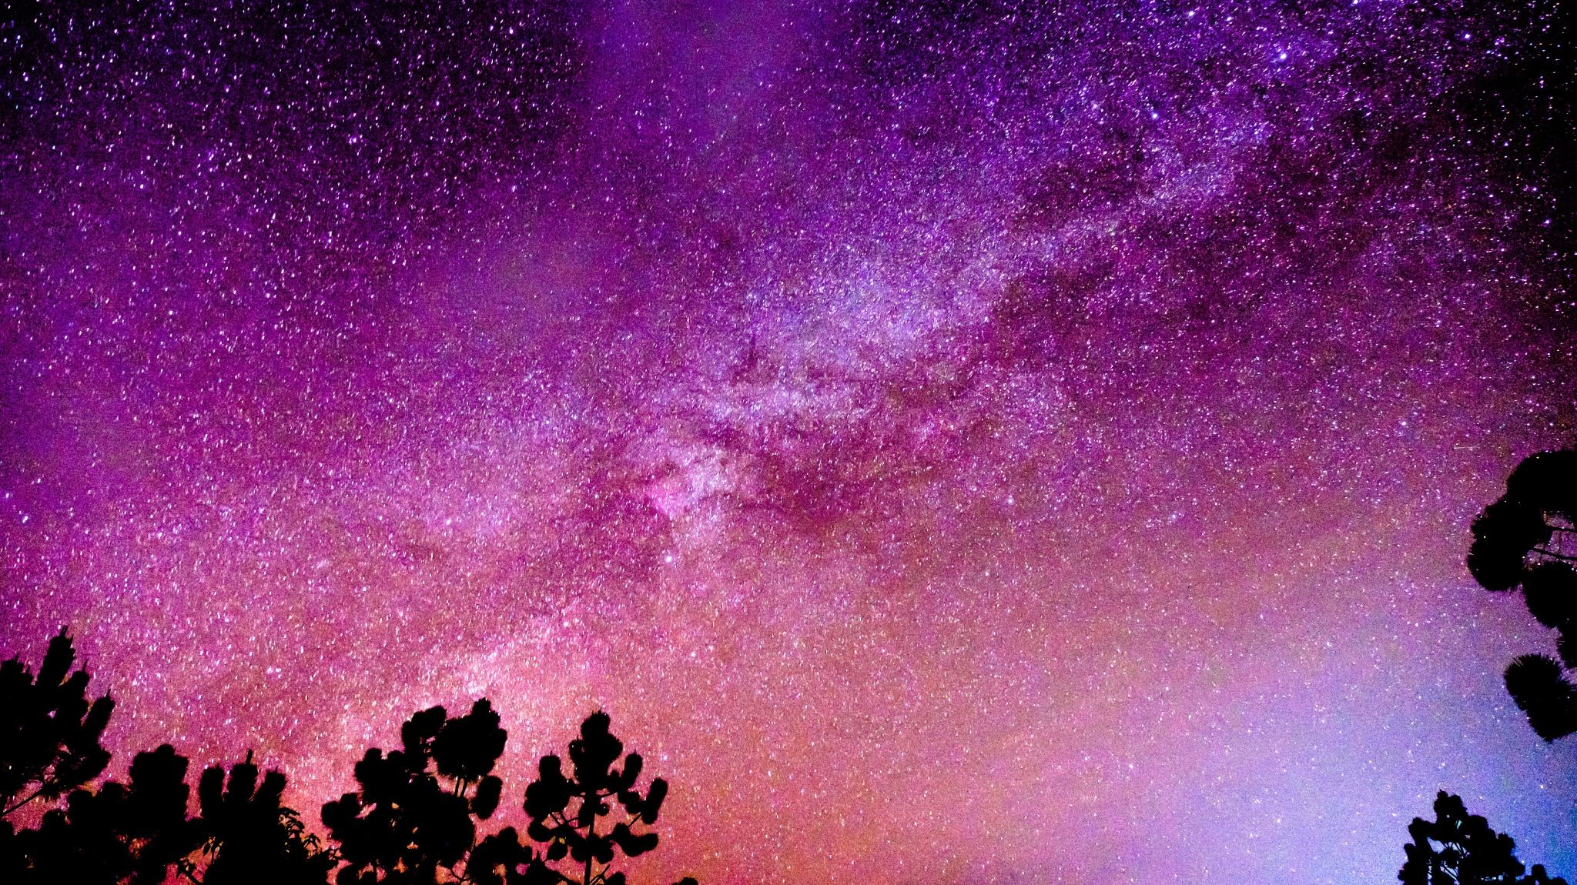
High Resolution Mapping of Surface Ozone Concentrations with Machine Learning and Geostatistics: A Case Study in Arizona
by: Ryan Erickson

Slide 2
Health Concerns of Increasing Surface-Ozone concentrations Overtime
leading environmental risk factors for premature deaths (IPCC & WMO, 1992; WHO, 2013)
Short- and long-term surface O₃ need to be thoroughly investigated
worrying evidence theorizes that O₃ may affect populations disproportionally due to a myriad of ecological factors
Severe cases of interactions which need to be supported
chronic obstructive pulmonary disease (COPD)
elderly cognitive impairment (Turner Literature)
pro-thrombosis
pediatric asthma (Balmes, 2019; Gao et al., 2022; Niu et al., 2022)
generally induces inflammation

Slide 3
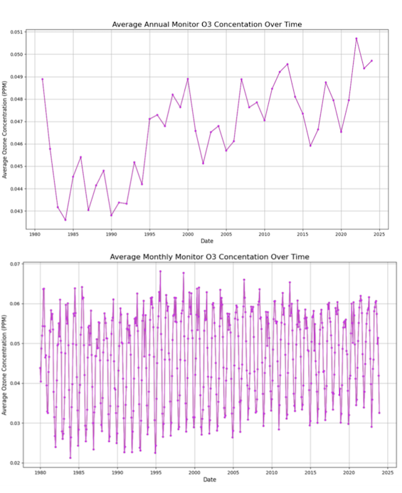
Literature Review
Recent Years and Models show:
Areas with little to no natural surface-ozone are increasing density during typical production seasons
Monitoring and Prediction of future Ozone Cycles may help spread awareness, reduce health interactions, or disprove theorized interactions which may not be present
Ozone Reactions are likely to increase in high-population/construction areas
Rapid changes of low and high exposure ozone concentrations are due to high variance of personal, societal and environmental interactions

Slide 4
Literature Review (Cont.)
Higher Spatio-Temporal Models Provide fast access to exposure data for researchers invested in health interactions
Remote sensing methods have worked well but:
Need large amounts of storage
Requires large processing power to timely outputs
Slow methodology on most conventional laptops and home computers
Models used in current health and atmospheric chemistry literature yield high accuracy but:
Typically requires large amounts of processing power
Necessitates access to institutional or privatized imagery
Missing geographical corrections

Slide 5
Methodology
Create a quick, streamlined process to rapidly choose the fastest, most accurate model to create high resolution imagery to be combined with coarse tile imagery.

Slide 6
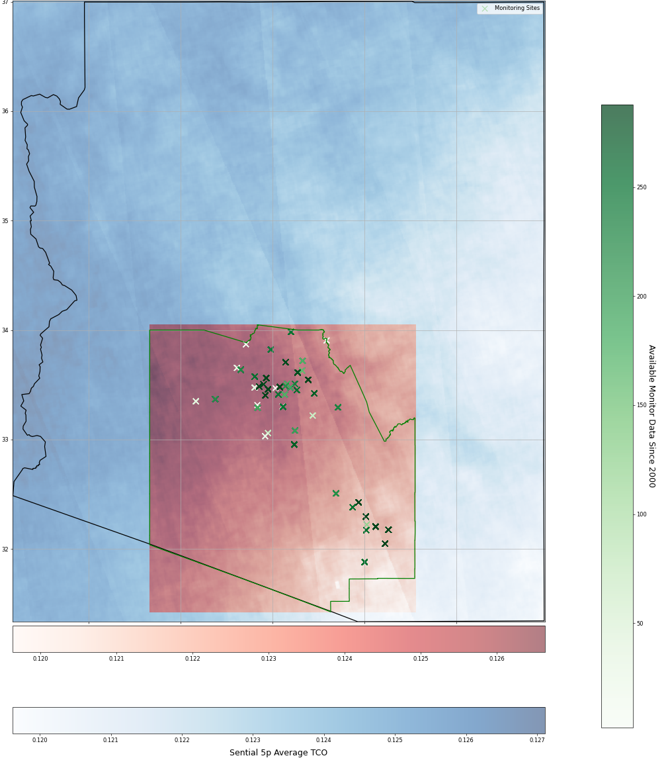
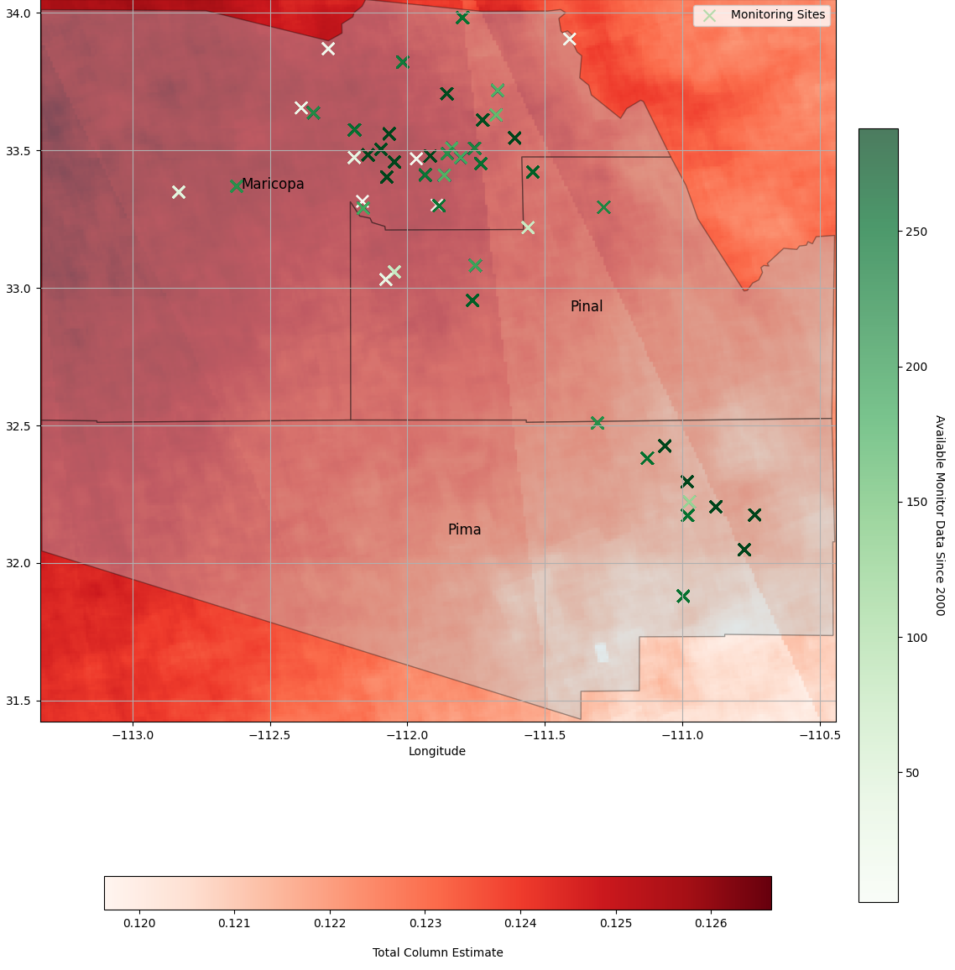
Model Distributions – Better Maps Incoming
Model Distributions Across Arizona
Monitor Distributions Across PHOTUC Region

Slide 7
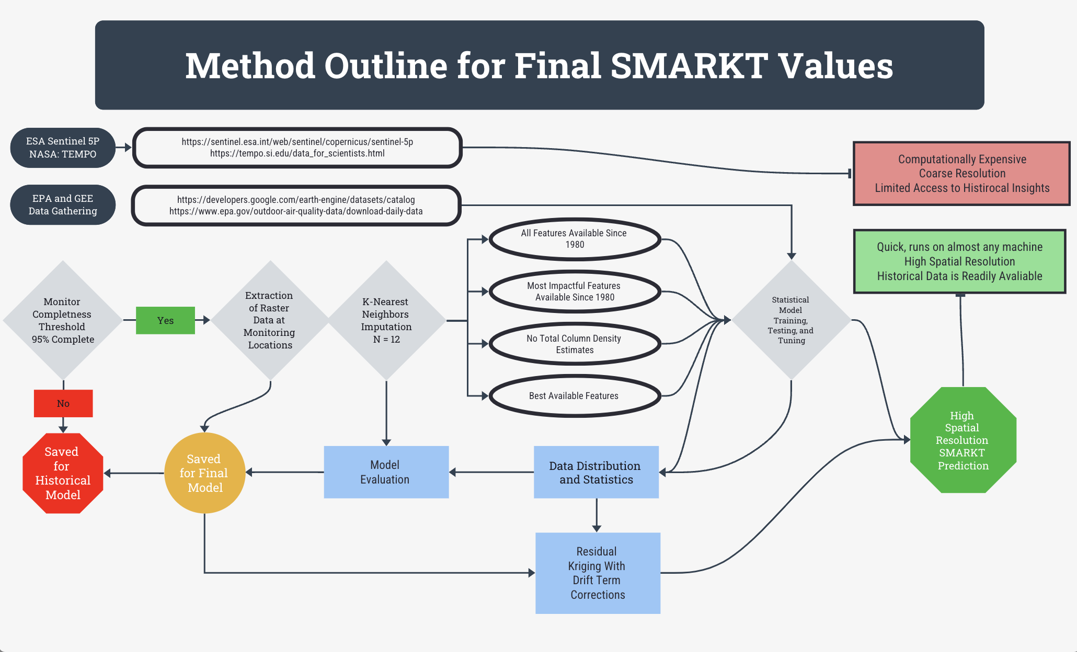

Slide 8
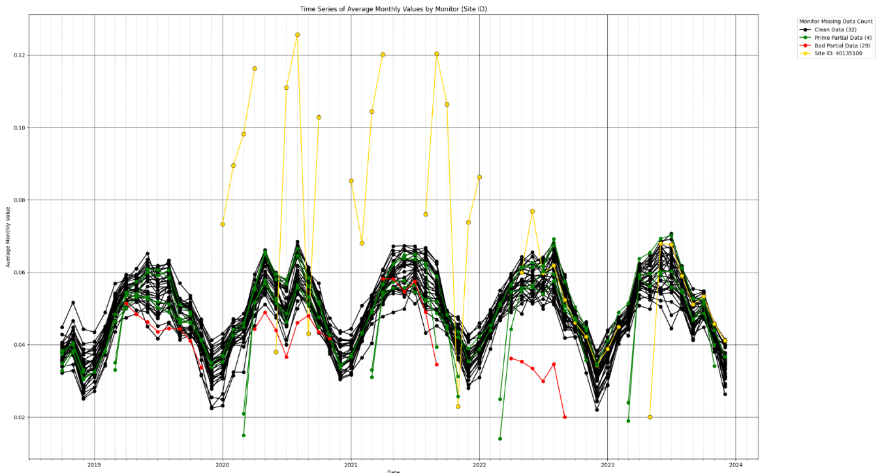
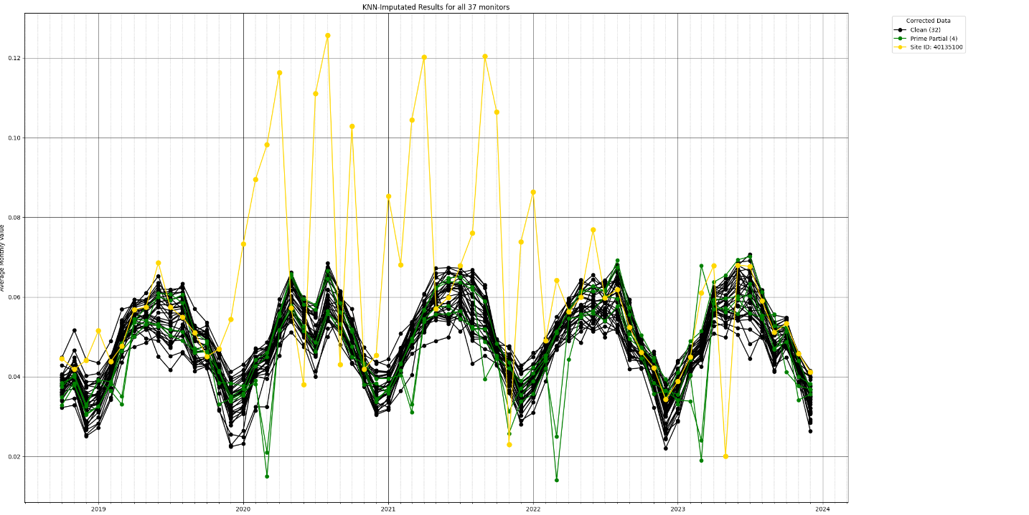
Imputated Monitor Values
Complete data is hard to find
the EPA, the world's leading institution on air pollution monitoring, is as close to complete as it gets but it's still a little noisy.
Above plot depicts which monitors were okay to imputate over and which ones required removal.
Red = Bad
Green = Good
Gold = Outlier site – Can be used for imputation
All monitor averages shown in slide 2

Slide 9
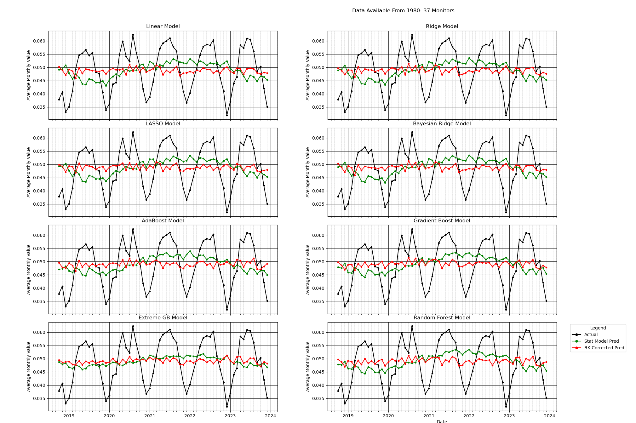


Predicted Results Per Statistical Model (SM)
Each Statistical Model (SM) is represented by a green line while each SM-residual kriging (SM-RK)
Each model benefits from RK method because:
The overall error using RK is corrected, with a tendency to vastly improve under predictions while overcorrecting over predictions
This matches seasonal variations in ozone, the SM-RK method is a better predictor for high-production (Summer) months
Combining SM predictions during low-production months and SM-RK during high-production months would provide best predictions (plots coming soon)

Slide 10
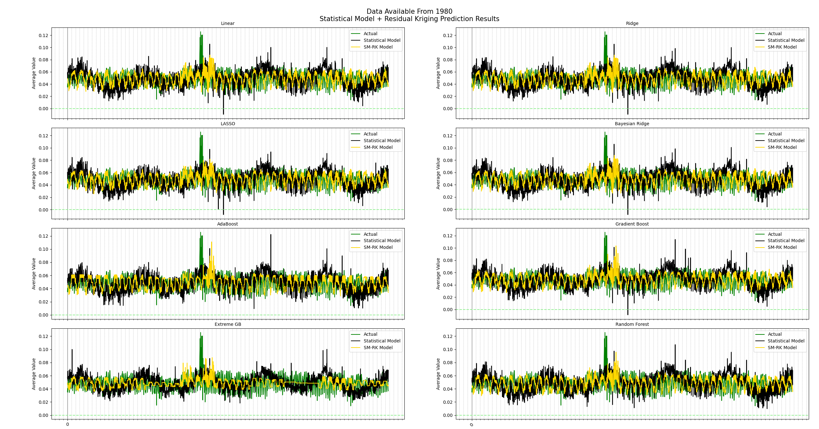
Predicted Results: SM-RK Improvement Per Monitor One dataset – Legend labels are WRONG
These are monitor/date plots. Each index represents a monitor+date combination. The Statistical prediction (gold) doesn’t vary much from the overall trend of monitor O3 concentrations. SM-RK (black) improvement reduces spatial error and is typically more consistent with the actual value (green) by capturing the spatial error and applying it to the model.

